Slide 1
EXECUTIVE PROJECT REPORT
Telecom Customer Churn Analysis
AI-Augmented Data Analytics Pipeline Powered by Excel, Power BI & Generative AI
Microsoft Excel
Power BI Desktop
AI Tools & GenAI

Slide 2
EXECUTIVE SUMMARY
The Business Challenge & Project Scope
Root-Cause Detection
Uncover contract, payment, and service attrition triggers.
PRIMARY CHURN RATE
26.5%
Cross-Tool Pipeline
Integrated workflow across Excel, Power BI, and GenAI models.
Severe subscriber attrition impacting annual recurring revenue.
Retention Strategy
Deploy targeted business interventions to protect revenue.

Slide 3



METHODOLOGY & TOOLSET
End-to-End Analytics Architecture
Microsoft Excel
Power BI Desktop
AI Tools & GenAI
Data cleaning and missing value imputation.
Relational modeling and complex DAX measures.
Automated DAX authoring and risk clustering.

Slide 4
TELEMETRY BASELINE
Telecom Customer Churn Baseline
7,043
26.5%
1,869
$139K
Total Subscribers
Overall Churn Rate
Lost Customers
Monthly Lost Revenue

Slide 5
DATA ENGINEERING
Excel Wrangling & Feature Engineering
01
02
03
TotalCharges Imputation
Tenure Cohort Binning
Categorical Normalization
Cleaned 11 null records seamlessly.
Built 5 distinct lifecycle groups.
Standardized senior and service flags.

Slide 6
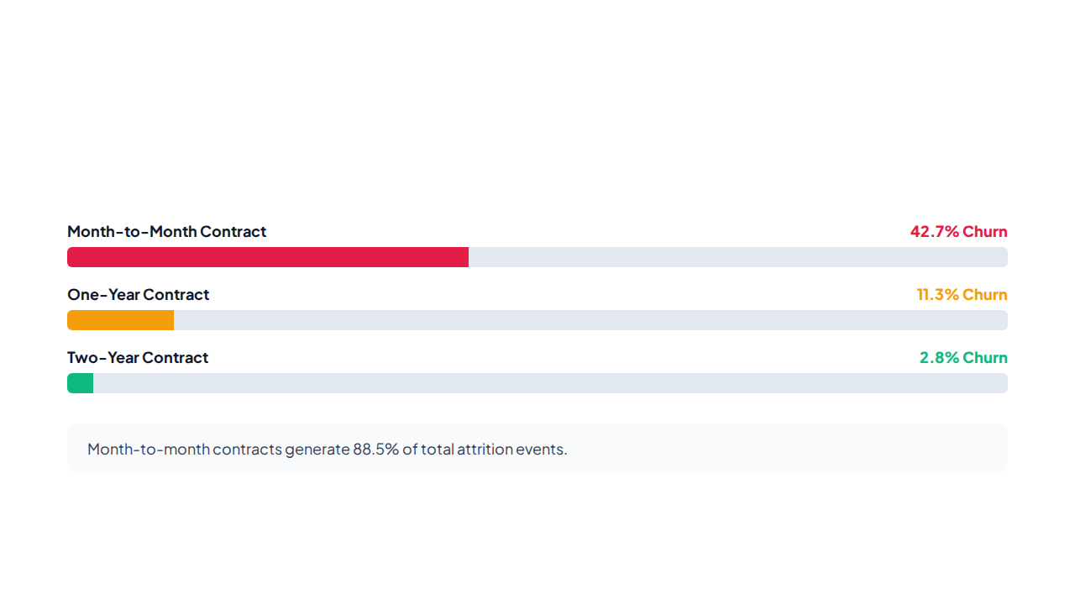
CORE FINDING #1
Contract Duration vs. Churn Rate

Slide 7
CORE FINDING #2
Service Add-On Risk Profiling
High Churn Exposure
Retention Anchors
Fiber Optic: 41.9% Churn rate without security.
Online Security: Churn drops to 14.6%.
Tech Support Absent: 41.6% Subscriber departure rate.
Active Tech Support: Churn reduced below 15.2%.
First Year Users: 47.4% High onboarding vulnerability.
Partner Plans: Higher retention among families.

Slide 8
CORE FINDING #3
Payment Method Attrition Breakdown
45.2%
15.9%
14.8%
Electronic Check
Bank Transfer Auto
Credit Card Auto
Highest overall subscriber exit rate.
Stable recurring payment retention.
Lowest churn billing mechanism.

Slide 9

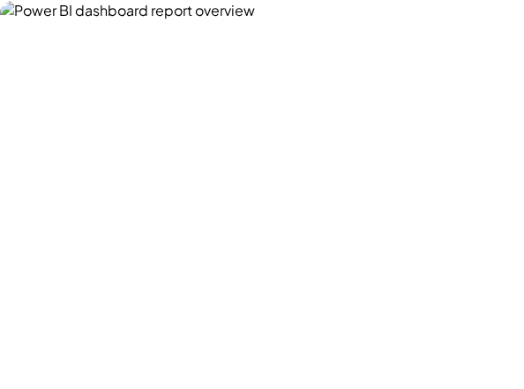
BI IMPLEMENTATION
Interactive Power BI Dashboard
Executive Overview
High-level North-Star churn metrics.
Demographic Deep-Dive
Risk breakdowns across senior citizens.
Billing & Services
Payment method and add-on correlations.

Slide 10



GENAI ACCELERATION
AI-Augmented Analytics Workflow
DAX Measure Authoring
Pattern Clustering
Executive Briefings
Generated complex cohort retention measures.
Synthesized multi-variable risk clusters.
Drafted crisp stakeholder takeaways.

Slide 11
ACTIONABLE STRATEGY
Customer Retention Action Plan
01
02
03
04
Contract Upgrades
Auto-Pay Adoption
Support Bundles
Proactive Outreach
Incentivize annual contract migrations.
Offer small billing discounts.
Bundle free online security.
Flag early at-risk accounts.

Slide 12
PROJECTED BUSINESS IMPACT
$350,000+
Projected Annual Recurring Revenue Saved by Reducing Churn Below 18%
Questions & Discussion

Slide 13

Image Sources
https://nextgentemplates.com/wp-content/uploads/2025/07/Telecommunications-Dashboard-in-Power-BI-1.jpg
Source: nextgentemplates.com

